Slide 1







Express.js Fundamentals
Course Overview,
Trainers, Evaluation
Express.js Development
SoftUni Team
Technical Trainers
Software University
http://softuni.bg

Slide 2



Table of Contents
Course Objectives
Course Program
Trainers Team
Course Schedule
Exams and Evaluation
Learning Resources

Slide 3
Have a Question?
sli.do #js-web

Slide 4






SoftUni Diamond Partners

Slide 5






SoftUni Diamond Partners

Slide 6




JavaScript Web
Module Overview

Slide 7
JS Web Module Goals
3 months intensive JavaScript framework training
4 times weekly, lots of live coding, homework and projects
Part I – Express.js
Node.js, MongoDB, Express.js Web Server
Part II – React.js
React basics, JSX, components, Redux connection
Part III – Angular
Angular basics, TypeScript, Service and Dependency Injection

Slide 8
Module Timeline
21-May-2018
19-June-2018
17-July-2018
Express.js
8 credits
4 weeks x 4 times / week
Final exam: 17-June-2018
React
8 credits
4 weeks x 4 times / week
Final exam: 15-July-2018
Angular
8 credits
4 weeks x 4 times / week
Final exam: 12-August-2018

Slide 9



Express.js Fundamentals
Express.js Fundamentals
Course Objectives & Program

Slide 10
Course Objectives
Extend the skills, gained in JS Core, by introducing server-side JavaScript technologies
Learn to use the most common techniques in web development
Apply the fundamentals of application architecture and code convention through the MVC pattern
Requirements
HTML & JS (ES 2016) coding skills – intermediate level
Computer English – entry level

Slide 11
Course Topics
Introduction to HTTP and Node.js
Node Web Server and Development Tools
Persistence – Files and MongoDB
Introduction to Express.js
View Engines
Authentication
Architecture & Code Styling

Slide 12

The Trainers Team

Slide 13

Trainers Team
Ivaylo Kenov
Various job titles at the same time:
Mathematical competitions champion
Full Stack Technical Trainer
Senior Software Developer
Solutions Architect & Technical Lead
One-man army @ https://MyTestedASP.NET
{Insert Jot Title Here}
Contacts
https://github.com/ivaylokenov
https://facebook.com/ivaylo.kenov
https://linkedin.com/in/kenov

Slide 14
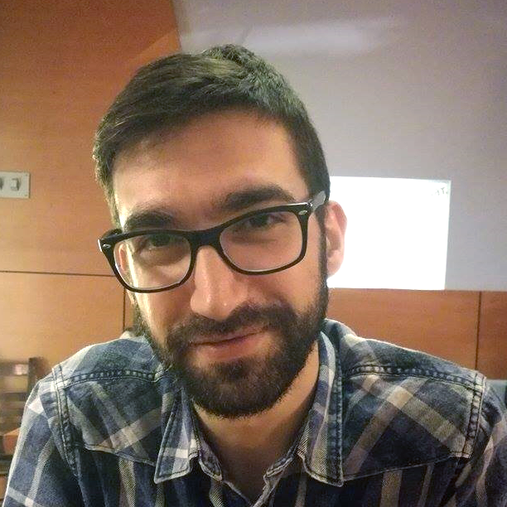
Trainers Team (2)
Viktor Kostadinov
Training Director @ Software University
Experienced Technical Trainer
Passionate about JavaScript
Programmed as a hobby since high school
Interests include astronomy and game development

Slide 15

Training Duration
Lessons: ~30 hours (onsite + videos)
Practical exercises (in class): ~30 hours
Exam: 6 hours
Exam date: 17 June 2018

Slide 16



Learn to Search Online
The course assignments require searching online
This is an important part of the learning process
Some exercises intentionally have no hints
Learn to find solutions!
Software development includes everyday searching and learning
No excuses, just learn to study!
Developers learn new technologies, tools, languages every day!

Slide 17


Scoring System for the Course
Exam – 90%
Homework (exercises) – 10%
Bonuses: up to 10%
Presence in class: 5% (onsite students only)
Forum activities: 5%

Slide 18

Homework Assignments
Doing your homework is very important!
Programming can only be learned through a lot of practice!
You should write code every day!
Each lesson is followed by many exercises
Try to solve them in class
The rest are your homework
Homework assignments are due 7 days after each lecture
Submission through the course page

Slide 19










Resources
What We Need Additionally?

Slide 20


Your RFID Chip
Students can either
Take RFID chip from SoftUni
Or use their own chip / card (125 KHz)
Register your chip number in your SoftUni profile: https://softuni.bg/users/profile/show
Check-in at the reception every time when you come in SoftUni
See your last visits in your profile: https://softuni.bg/users/profile/show

Slide 21



Course Web Site, Forum and FB Group
Official web site:
Official discussion forum:
Official Facebook group:
softuni.bg/courses/express-js-fundamentals
softuni.bg/forum/categories/107/js-web
fb.com/groups/SoftUniJSWebMay2018

Slide 22

The Software Technologies Slides and Videos
All lecture slides, videos, homework assignments, projects and other resources are open content, available for free
Visit the course web site to access the course resources

Slide 23
Recommended Software
Software needed for this course:
Node.js (Current Version) - https://nodejs.org/en/download/
MongoDB - https://www.mongodb.com/download-center
Visual Studio Code – https://www.visualstudio.com
or
WebStorm – https://jetbrains.com/webstorm/

Slide 24







Course Introduction
https://softuni.bg/courses/

Slide 25
License
This course (slides, examples, demos, videos, homework, etc.) is licensed under the "Creative Commons Attribution-NonCommercial-ShareAlike 4.0 International" license

Slide 26





Trainings @ Software University (SoftUni)
Software University – High-Quality Education, Profession and Job for Software Developers
softuni.bg
Software University Foundation
http://softuni.foundation/
Software University @ Facebook
facebook.com/SoftwareUniversity
Software University Forums
forum.softuni.bg

